Slide 1
Airline Booking Information Management System
GROUP 14

Slide 2
GROUP 14
Đặng Hùng Kiên Bi9-133
Lê Duy Anh Bi9-034
Lê Phước Long Bi9-153
Nguyễn Thanh Trang Bi9-219

Slide 3
TABLE OF CONTENT
Introduction
Structure
Demo
Conclusion

Slide 4
INTRODUCTION
What?
Airline Booking Information Management System contains the detail about flight schedules, passenger information like their name, date of birth, their reservations and ticket records.

Slide 5
INTRODUCTION
Why?
Airline reservation system helps travel companies to integrate all flight-related data into online portal to provide customer with wide variety of flight options with competitive flight fares.

Slide 6
II. Structure:
01
Classes
02
Module & Packages
03
Database

Slide 7
Classes
Airlines booking class: manage all the operation of Airlines booking.
Staff class: manage all the operation of staff.
Ticket booking class: manage all the operation of Ticket booking.

Slide 8
2. Modules & Package
Registration module: ask passenger their information, passenger can login their account and view all flight detail
Administration module: admin can manage the site, update, delete, view passenger list, cancel ticket, update flight schedule
Passenger module: user can login their account to view schedule, book ticket, cancel ticket
Package: tkinter: package that made UI

Slide 9
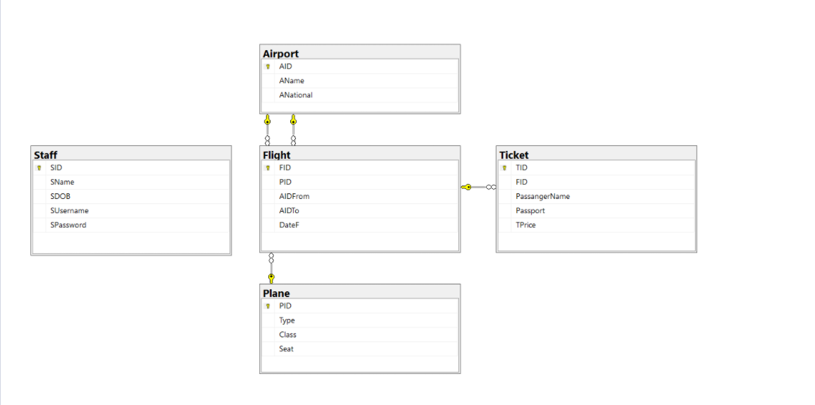
3. Database

Slide 10
III. Demo

Slide 11
IV. Conclusion
We have done GUI and database
But we can’t connect to database

Slide 12

Thank you!

